Slide 1


Fundamentals of Risk Management
RM System, Process, & Program
Incident Investigation & Analysis
RM Tools & Challenges
People & Organizations
RM as Applied in Industry
Leadership in RM
Applications & Perspectives
On Becoming a
Leader in Risk Management
ENGG404 - Lecture
Case 13: The Imperative for Leadership and the Boeing 737 MAX MCAS Failure Loss Incidents 2018/2019

Slide 2
Learning Outcomes:
Argue in favour of why leadership in risk management is critical to success of the organization:
The need for management leadership, commitment, and accountability at all levels, and
Upholding the underlying safety values for what drives those needs.
Critique management leadership (or lack thereof) in a major organization.
Develop your personal commitment to safety, and carry this lesson forward especially when you are responsible for creating the right safety culture. “We, engineers and leaders in risk management, are in the business of risk management and we must never lose the imperative for safety.”
Further develop latent cause statements.
Create a recommendation for action for a latent cause.
Case 13: Boeing 737 MAX MCAS Failure 2018/2019
‹#›
Notes:
‹#›

Slide 3
Background:
Competitive Pressures:
Boeing (an American company) was under competitive pressure from Airbus (a European consortium) to deliver a new 737 plane.
This pressure caused Boeing and the Federal Aviation Administration (FAA, a US Government agency) to rush the approval process to push the new 737 MAX model to the market.
Boeing decided to re-design the 737, as re-designing is faster, requires less training, requires a less thorough review and approval process by the FAA, is more cost effective than designing a new aircraft, and as a re-design, costly upgrade training would be avoided, ~$1MM per jet.
However, test pilots and engineers noticed the tendency for the re-designed aircraft to fly “nose-up” with increased potential to stall;
This was caused by the relocation of the engines to the front of the wing
Therefore, the Maneuvering Characteristics Augmentation System (MCAS) was installed.
This was done to allow pilots to easily adapt flight characteristics of the jet to the new location of the engine.
Case 13: Boeing 737 MAX MCAS Failure 2018/2019
‹#›
Notes:
‹#›

Slide 4
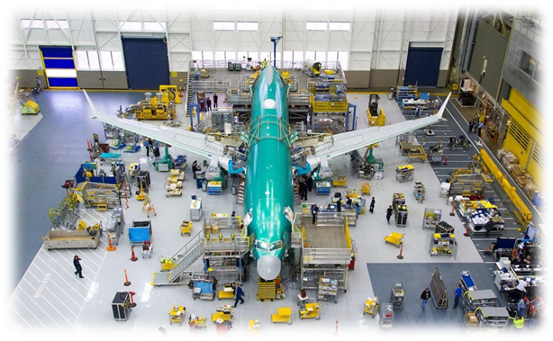
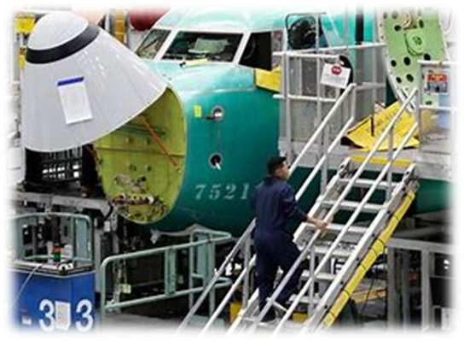
Background:
Design Philosophy:
The MCAS was implemented to mimic the operation and handling of previous 737 models, thus allowing for easier transition to the 737 MAX.
The MCAS was not extensively tested on the 737 MAX. It was primarily used for military applications, meaning it needed modification and testing before being used in commercial airlines.
Boeing chose to not include the MCAS in pilot manuals and mandatory training.
Case 13: Boeing 737 MAX MCAS Failure 2018/2019
‹#›
Notes:
‹#›

Slide 5
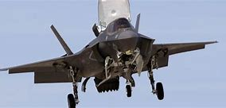
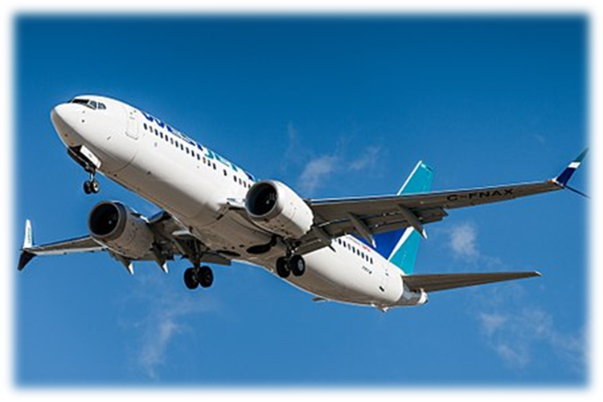
The Situation:
Boeing assumed the pilots would be able to mitigate any potential malfunction with the plane, even though MCAS was not included in pilot manuals and mandatory training.
Boeing engineers decided to install a single sensor to gather data on how the aircraft was angled during flight (AOA sensor). Two sensors are commonly used to reduce the chance of error in reading the data.
When the AOA sensor malfunctioned on takeoff, engaging the MCAS system (pushing the plane’s nose down), the pilots did not know the MCAS system was being activated and did not know how to respond.
Case 13: Boeing 737 MAX MCAS Failure 2018/2019
‹#›
Notes:
‹#›
Military flights are high-speed (up to 3200 km/h) and commercial flights are not (up to 1000 km/h)

Slide 6
The Issue:
Because Boeing and the FAA rushed the approval process, many risks were overlooked or not properly assessed.
MCAS capabilities and what it was supposed to control were never fully revealed to the FAA.
The MCAS that was originally presented to FAA was not the system that ended up in the planes.
The operation of MCAS violated Boeing’s own design guidelines, which stated that the system should not have “any objectionable interaction with the piloting of the airplane” and “not interfere with dive recovery”; the MCAS was not designated as a safety-critical system.
Boeing Authorized Representatives (BAR: Boeing employees who are granted special permission to represent the interests of the FAA) raised concerns about the safety of the MCAS system within Boeing (which were ignored), and did not disclose the issues to the FAA.
FAA management over ruled its own technical experts in favor of Boeing (detrimental impact on morale at FAA).
Case 13: Boeing 737 MAX MCAS Failure 2018/2019
‹#›
Notes:
‹#›
AR = authorized representatives. Boeing employees who are granted special permission to represent the interests of the FAA and to act on the agency’s behalf in validating aircraft systems and design compliance with FAA requirements

Slide 7
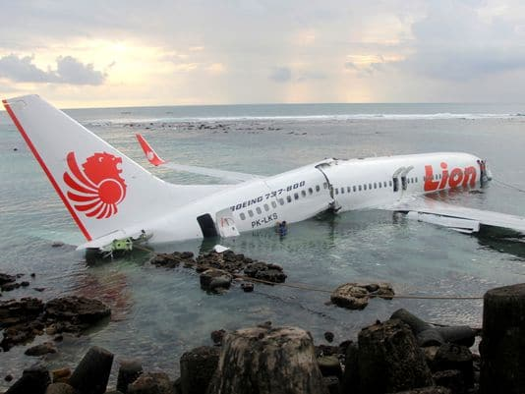
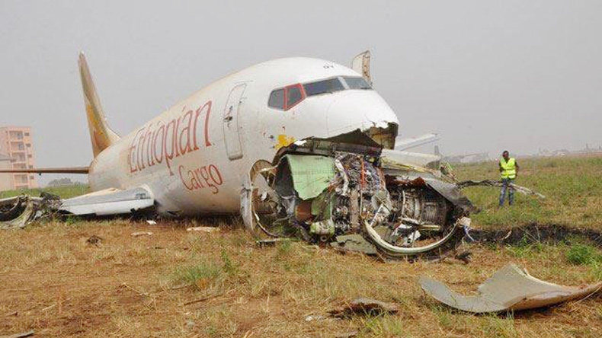
The Issue:
According to the FAA, the addition of the MCAS did not need a thorough assessment because it was not considered to be a critical safety component of the 737 MAX.
Boeing believed the addition of the MCAS would resolve any issues with retrofitting the engines in the 737 MAX.
Neither Boeing nor the FAA fully understood how much control the MCAS had, and how this could impact the operation of the aircraft
Case 13: Boeing 737 MAX MCAS Failure 2018/2019
‹#›
Notes:
‹#›

Slide 8
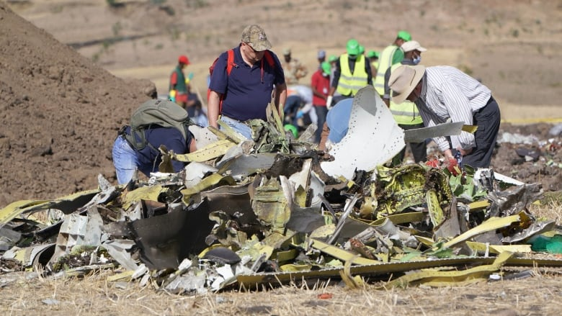
Two Hull Losses and The Consequences:
Consequences / Impact on PEAP:
Lion Air – 189 dead
Ethiopian Airlines – 157 dead
2 aircraft completely destroyed
Cleanup of crash site for Ethiopian Flight
All 737 MAX aircrafts grounded
Boeing stock price decreased by 40%
Potentially tens of billions of $’s in litigation
CBC News: 9-March-2020
Case 13: Boeing 737 MAX MCAS Failure 2018/2019
‹#›
Notes:
‹#›

Slide 9
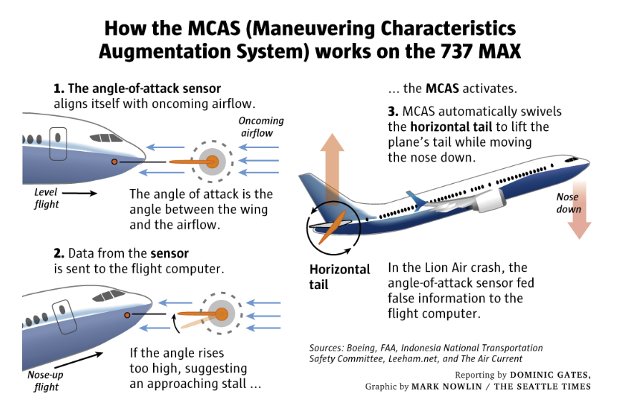
‹#›
Case 13: Boeing 737 MAX MCAS Failure 2018/2019
‹#›

Slide 10
Immediate Causes:
Sub-standard Conditions:
the Angle of Attack Sensor (AOAS) failed, AND
the Maneuvering Characteristics Augmentation System (MCAS) responded by “pushing the nose down”, AND
The MCAS could not be over-ridden.
Sub-standard Practices:
There was no pilot error:
Any actions the pilots tried to take could not rectify a nose-down attitude (pitch) i.e. the pilots could not over-ride the MCAS.
Pilots were not only not trained on how to over-ride the MCAS, they were not even informed of the existence and functionality of the MCAS!
Case 13: Boeing 737 MAX MCAS Failure 2018/2019
‹#›
Notes:
‹#›

Slide 11
Basic Causes - Engineering and Design Factors:
Inadequate inherently safe design / lack of redundancy: Decision was made by Boeing engineers to use only one input sensor for the MCAS
Inadequate documentation of change: Boeing (and the FAA) was not fully informed about how the MCAS system operated.
Inadequate assessment of loss exposures / risks / hazards: Consequences of retrofitting engines not properly evaluated by Boeing engineers
Inadequate monitoring of initial operation: Boeing wanted to limit changes to design to avoid additional pilot training
Inadequate training: Pilots were not trained about the MCAS and had no skill capability to respond when the MCAS system engaged incorrectly.
Case 13: Boeing 737 MAX MCAS Failure 2018/2019
‹#›
Notes:
‹#›

Slide 12
Basic Causes - Job Factors:
Inadequate communication: Boeing did not properly communicate the design changes to the FAA.
Inadequate job procedures: Pilots were not aware of the addition of the MCAS to the aircrafts (not included in the training manuals).
Organizational factors: Boeing design change documents were not thoroughly reviewed by FAA
Organizational factors / Incompatible Goals: Boeing Authorized Reps were ignored by Boeing management and did not inform FAA of their concerns.
Case 13: Boeing 737 MAX MCAS Failure 2018/2019
‹#›
Notes:
‹#›

Slide 13
Latent Causes by Risk Management System Elements:
RME #4: Management of Change
Boeing management assumed that the addition and re-design of the MCAS would not introduce additional risk to the operation of the aircraft.
  This included changes such as using a single angle of attack sensor to collect data for MCAS engagement instead of two sensors, adding low speed stall scenarios to the scope and engagement rules of MCAS, and neglecting to add MCAS engagement scenarios to training manuals or mandatory training for pilots
LC-S: The management of change program at Boeing did not include a standard to initiate a broad risk assessment of a new or revised engineered system, such as the MCAS system or re-positioned and more powerful engines, when being integrated into the Boeing 737 standard aircraft design. #4 MOC
Case 13: Boeing 737 MAX MCAS Failure 2018/2019
‹#›
Notes:
‹#›

Slide 14
Latent Causes by Risk Management System Elements:
RME #7: Design, Construction, and Startup
The MCAS was only tested in situations where it would work ideally. This included: single use cases; no tests were performed in a case for continuous MCAS engagement; F.A.A. regulations did not require Boeing to further assess the MCAS as it was not considered a critical component of the 737 MAX.
LC-S: The design program at Boeing did not include a standard to initiate a thorough design review of nor a flight test plan for proposed designs, new and revised, when being fully integrated into the Boeing 737 standard aircraft design. #7 DCSU
Case 13: Boeing 737 MAX MCAS Failure 2018/2019
‹#›
Notes:
‹#›

Slide 15
Latent Causes by Risk Management System Elements:
RME #11: Operations and Facilities Information and Documentation
Information about the new MCAS system was not included in the pilot manual and mandatory training.
Boeing management believed the MCAS would not have a major impact on the aircraft operation, therefore the pilots did not need to know about it.
LC-S: The documentation program did not include a procedure to distribute new information for new and revised designs, such as the MCAS System, to pilot flight manuals and training programs. #11 OFID
Case 13: Boeing 737 MAX MCAS Failure 2018/2019
‹#›
Notes:
‹#›

Slide 16
Latent Causes by Risk Management System Elements:
RME #6: Program Evaluation and Continuous Improvement
Boeing engineers did not re-evaluate the MCAS through either a design program or a management of change program. The updated MCAS never got a second-look as it was believed it would not significantly alter the characteristics of the aircraft.
LC-S: The evaluation (auditing) program at Boeing did not include a standard to evaluate the effectiveness of the MOC program to initiate a formal risk assessment when integrating new or revised engineering controls such as the MCAS. #6 PECI
LC-S: The evaluation (auditing) program at Boeing did not include a standard to evaluate the effectiveness of the Design program to initiate a formal design review when integrating new or revised engineering controls such as the MCAS. #6 PECI
Case 13: Boeing 737 MAX MCAS Failure 2018/2019
‹#›
Notes:
‹#›

Slide 17
List of LC’s re: #4MOC, #7 DCSU, #11 OFID, #6 PECI
LC-S: The management of change program at Boeing did not include a standard to initiate a broad risk assessment of a new or revised engineered system, such as the MCAS system or re-positioned and more powerful engines, when being integrated into the Boeing 737 standard aircraft design. #4 MOC
LC-S: The design program at Boeing did not include a standard to initiate a thorough design review of nor a flight test plan for proposed designs, new and revised, when being fully integrated into the Boeing 737 standard aircraft design. #7 DCSU
LC-S: The documentation program did not include a procedure to distribute new information for new and revised designs, such as the MCAS System, to pilot flight manuals and training programs. #11 OFID
LC-S: The evaluation (auditing) program at Boeing did not include a standard to evaluate the effectiveness of the MOC program to initiate a formal risk assessment when integrating new or revised engineering controls such as the MCAS. #6 PECI
LC-S: The evaluation (auditing) program at Boeing did not include a standard to evaluate the effectiveness of the Design program to initiate a formal design review when integrating new or revised engineering controls such as the MCAS. #6 PECI
Case 13: Boeing 737 MAX MCAS Failure 2018/2019
‹#›
Notes:
‹#›

Slide 18
Example: Recommendations for Actions
LC-S: The management of change program at Boeing did not include a standard to initiate a broad risk assessment of a new or revised engineered system, such as the MCAS system or re-positioned and more powerful engines, when being integrated into the Boeing 737 standard aircraft design. #4 MOC
Implement a standard in the MOC program to initiate a broad risk assessment of a new or revised engineered system when being integrated into the Boeing 737 standard aircraft design.
LC-S: The design program at Boeing did not include a standard to initiate a thorough design review of and flight test plan for proposed designs, new and revised, when being fully integrated into the Boeing 737 standard aircraft design. #7 DCSU
Implement a standard in the Design program to initiate a thorough design review of and flight test plan for proposed designs when being integrated into the Boeing 737 standard aircraft design.
LC-S: The documentation program did not include a procedure to distribute new information for new and revised designs, such as the MCAS System, to pilot flight manuals and training programs. #11 OFID
Implement a procedure to distribute new information for new and revised designs to pilot flight manuals and training programs.
Case 13: Boeing 737 MAX MCAS Failure 2018/2019
‹#›
Notes:
‹#›

Slide 19
Example: Recommendations for Actions
LC-S: The evaluation (auditing) program at Boeing did not include a standard to evaluate the effectiveness of the MOC program to initiate a formal risk assessment when integrating new or revised engineering controls such as the MCAS. #6 PECI
Implement a standard to evaluate the effectiveness of the MOC program to initiate a formal risk assessment when integrating new or revised engineering controls in existing aircraft designs.
LC-S: The evaluation (auditing) program at Boeing did not include a standard to evaluate the effectiveness of the Design program to initiate a formal design review when integrating new or revised engineering controls such as the MCAS. #6 PECI
Implement a standard to evaluate the effectiveness of the Design program to initiate a formal design review when integrating new or revised engineering controls in existing aircraft designs.
Case 13: Boeing 737 MAX MCAS Failure 2018/2019
‹#›
Notes:
‹#›

Slide 20
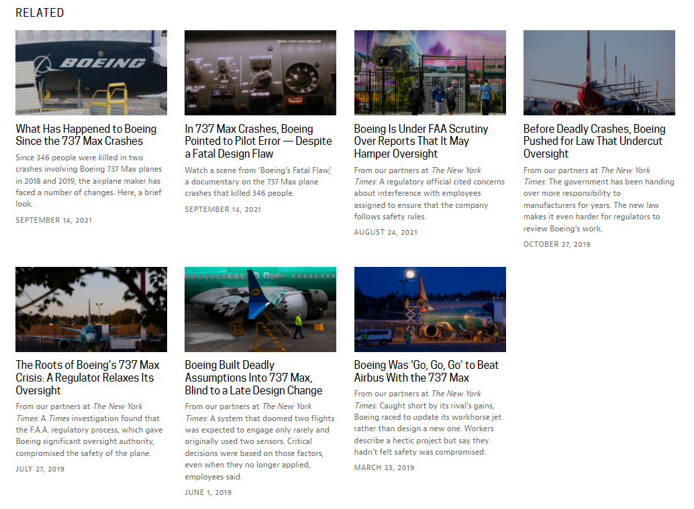
Let’s Talk About Culture … Some Insights into Boeing Culture:
Mass media insights give an indication of the culture at Boeing:
Case 13: Boeing 737 MAX MCAS Failure 2018/2019
‹#›
Notes:
‹#›

Slide 21
Discussion Points on RME #1 MLCA, 1 of 2:
RME #1: Management Leadership, Commitment, and Accountability:
As we will learn in an upcoming topic, culture is determined by leadership …
Boeing management directed employees to focus on beating out the competition to deliver a new plane over-shadowing the formerly strong sense of safety culture and values held by employees at Boeing.
The actions by Boeing demonstrated that the underlying values at Boeing reflected that safety was a priority, not a value i.e. safety objectives were prioritized along with commercial goals (increase profits, reduce costs, increase productivity and delivery i.e. the need to get the jet on the market at a competitive price versus the Airbus A320).
Major financial factors in the decisions that Boeing made were to avoid having:
To “certify” the Boeing 737-MAX as a new aircraft design (avoid the costs and time lost) instead of a “re-design”;
To compensate airline purchasers for $1MM per aircraft in training costs.
Case 13: Boeing 737 MAX MCAS Failure 2018/2019
‹#›
Notes:
‹#›

Slide 22
Discussion Points on RME #1 MLCA, 2 of 2:
RME #1: Management Leadership, Commitment, and Accountability:
Despite a long-standing safety culture at Boeing, it deteriorated during the development and commercialization of the 737 MAX.
The focus on safety had to compete with other objectives and thus became a lower priority.
Ultimately, Boeing's reputation, business, and financial rating suffered after hull losses and blanket groundings of the 737-MAX, questioning Boeing's strategy, governance, and focus on profits and cost efficiency (over flight safety of its products).
LC-C: The Leadership Program did not uphold commitment to and accountability for flight safety in order to sustain the Core Safety Values of the Company. #1 MLCA
Case 13: Boeing 737 MAX MCAS Failure 2018/2019
‹#›
Notes:
‹#›

Slide 23
Industry Responds: The Changes to the Aviation Industry
In the aftermath of the 737 MAX incidents, a U.S House Transportation Committee review claimed that Boeing has a “broken safety culture” and that the Federal Aviation Administration (FAA) needed to improve their oversight of Boeing.
The FAA intends to require aircraft manufacturers (like Boeing) to implement a Safety Management System (SMS), which is already required for airlines (such as Air Canada).
SMSs are used to assess the combined effectiveness of actions such as design, procedures and training at identifying, assessing and countering potential hazards.
Changes to how the FAA approves changes/additions to existing plane designs are currently being considered
Changes/additions only allowed for a maximum of 20 years to an original design
Review what areas the FAA can delegate oversight authority to the airlines
Boeing now plans to have two AOA sensors feed into the MCAS
The 737-MAX is now cleared to fly in Canada (as of January 2021)
Case 13: Boeing 737 MAX MCAS Failure 2018/2019
‹#›
Notes:
‹#›

Slide 24
Impacts of Senior Management on Culture:
In the News, 14-October-2021:
The US Department of Justice has formally charged Boeing’s former chief technical pilot for the 737-MAX aircraft on fraud charges.
The USDOJ alleges that “the former chief technical pilot provided ‘materially false, inaccurate, and incomplete information’ to the Federal Aviation Administration about MCAS and schemed to defraud Boeing’s US‑based airline customers to obtain tens of millions of dollars for Boeing. In an attempt to save Boeing money (~$1MM in training costs per aircraft), the chief technical pilot allegedly withheld critical information from regulators (the FAA).”
https://www.pbs.org/wgbh/frontline/article/boeing-former-pilot-indicted-mark-forkner-pleads-not-guilty/
https://apnews.com/article/business-texas-indictments-federal-aviation-administration-b5f4e0a403bc829cfdf249c80c8e4119
Boeing management created a culture where the chief technical pilot placed profits ahead of flight safety …
Case 13: Boeing 737 MAX MCAS Failure 2018/2019
‹#›
Notes:
‹#›

Slide 25
Summary and Key Lesson:
Summary:
Boeing was not in the “business of risk management”.
Significant failures in risk management by senior management consistently placed the financial objectives of commercializing the 737-MAX ahead of “flight safety”.
Boeing lost “the imperative for safety”.
Senior management were focused on commercial success of the 737-MAX to the extent that they sacrificed not only flight safety but their leading-edge safety culture.
It took many, many decades to develop a high performance safety culture BUT just a few years (from early-development of the 737-MAX to the first hull loss) to destroy that culture.
Key Lesson:
We, engineers and leaders in risk management, are in the business of risk management and we must never lose the imperative for safety.
Case 13: Boeing 737 MAX MCAS Failure 2018/2019
‹#›
Notes:
‹#›

